Slide 1
Project - Service Desk Modules
By
Team-B

Slide 2

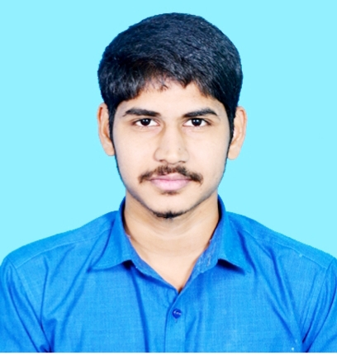
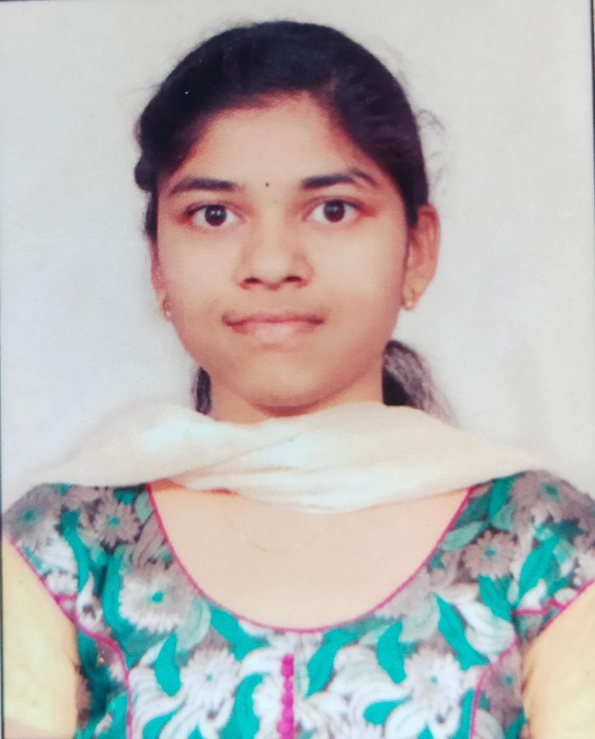
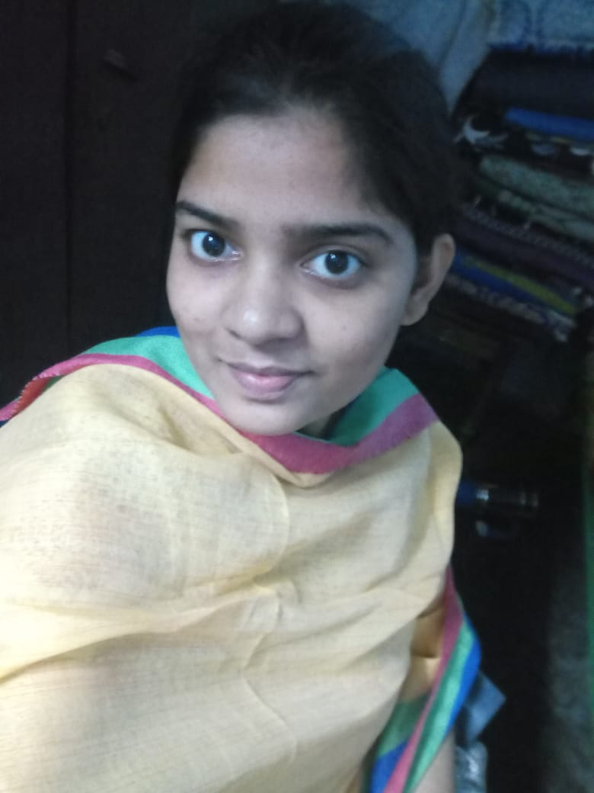

Team -B
Sai Mahesh Yarra
Poornima Dasari
Haritha Kotha
Divya Kandregula

Slide 3

Agenda
Objective
Architecture and Schema
Features
Demo and Implementation
Email Notification and Power Bi Report

Slide 4
Objective:
ServiceDesk application helps to connect all employees on single platform and can resolve issues of complex nature in no time.
Thus, user queries can be resolved much faster. They can also share information among all departments easily and proactively allocate resources to the right user/departments, thus increasing the productivity in the organization.

Slide 5
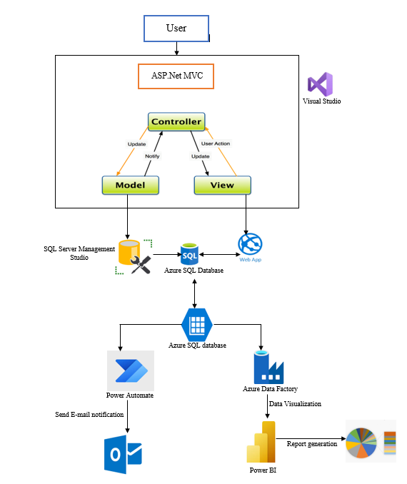
Architecture:

Slide 6
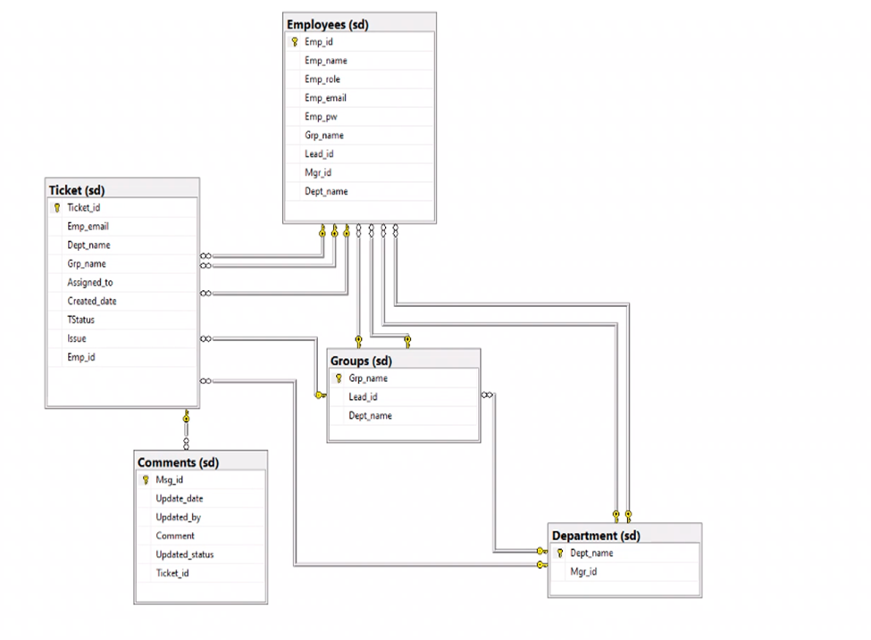
Schema:

Slide 7
Features:
Login
Landing Screen
Profile
My Tickets
New Tickets
Group Tickets
Department Tickets
Assigned Tickets
Employees
Mail Notification
Logout

Slide 8

Service Desk
Application

Slide 9
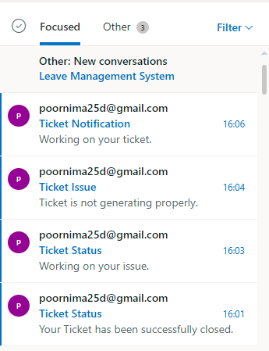
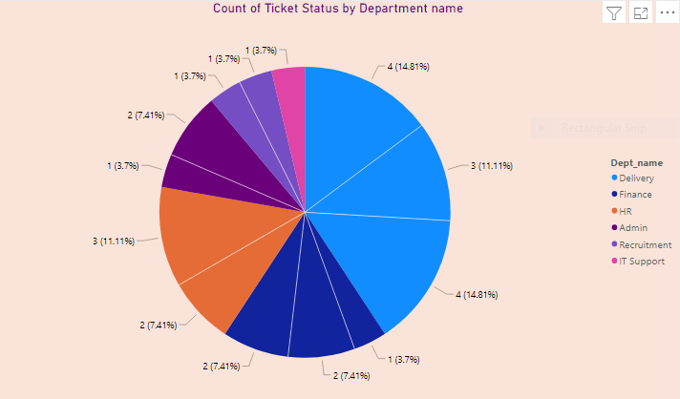
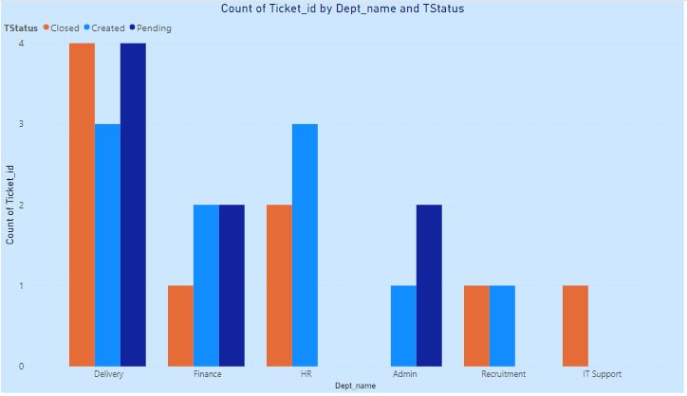
Email Notification and Power Bi Report:

Slide 10
APPENDIX​
Type | User Name | Password | Employee Id
Admin ​ | haritha.kotha@winwire.com | H@123 | 2202
Manager ​ | divya.kandregula@winwire.com | D@123 | 2203
Lead ​ | poornima.dasari@winwire.com | P@123 | 2201
User ​ | saimahesh.yarra@winwire.com | S@123 | 2208
ServiceDesk Application Link- http://teambwebapp.azurewebsites.net/
Power BI Report- https://app.powerbi.com/groups/me/dashboards/b41eafdb-7acc-4ee1-84b7-c6c8efbced16?ctid=bdcfaa46-3f69-4dfd-b3f7-c582bdfbb820

Slide 11
Thank You

